Slide 1
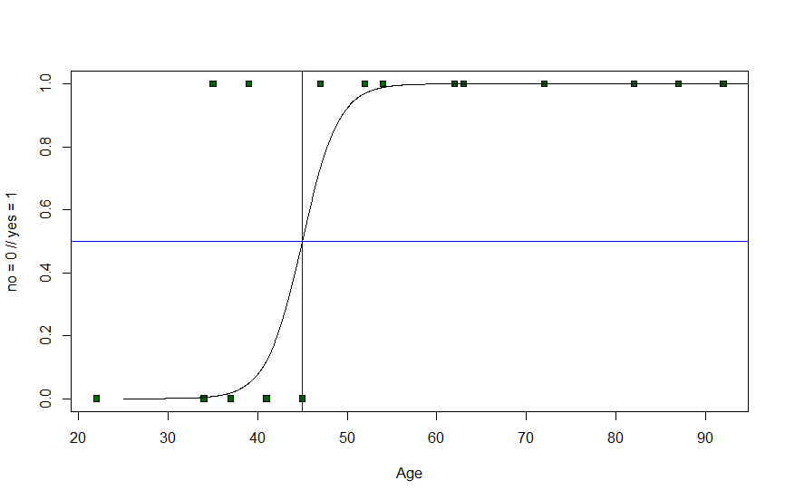
Descriptive statistics

Slide 2
Descriptive statistics
Things will start basic and then get more advanced as the course progresses…

Slide 3
Descriptive statistics
What are we going to learn in this section?

Slide 4
Descriptive statistics

Slide 5
Descriptive statistics
In Descriptive Statistics we use measures to describe key features of a dataset

Slide 6
Descriptive statistics
Height (in cm)
171
171
164
175
171
168
170

Slide 7
Descriptive statistics
Height (in cm)
171
171
164
175
171
168
170
Average = 170

Slide 8
Descriptive statistics
Height (in cm)
171
171
164
175
171
168
170
Average = 170
Most frequent value = 171

Slide 9
Descriptive statistics
Height (in cm)
171
171
164
175
171
168
170
Meausures of central tendency

Slide 10
Descriptive statistics
Height (in cm)
171
171
164
175
171
168
170
Meausures of central tendency
Meausures of spread

Slide 11

Probability theory

Slide 12
Probability theory
How to calculate probabilities?
Expected value
Bayes theorem
Central limit theorem
Law of large numbers
Real-life applications

Slide 13

Hypothesis testing

Slide 14
Hypothesis testing
How to set up a hypothesis?
How to perform an hypothesis test?
How to draw conclusions?
Statistical significance
p-value
Type I / II error
And more topics…

Slide 15
Dealing with missing data
What are we going to learn in this lecture?
 | Non-smoker | Weak smoker | Strong smoker
Younger | 4 | 5 | 5
Younger | 5 | 6 | 7
Older | 2 | 3 | 4
Older | 5 | 4 | 5

Slide 16
Dealing with missing data
How to approach missing data?
4 Strategies to deal with missing data

